Slide 1
Homework 2
Due on 9/26/2018 for class meeting on Mon & Wed
Due on 9/27/2018 for class meeting on Tue & Thu
1. (4pts) Consider a particle moving with the acceleration a (in unit of m/s² )vs. time t (in unit of s) graph as shown in Fig. 5. Assume the particle is at rest and at x = 1 at t = 0 sec. What is the position x of the particle at t =4sec.
Fig 1
6
1 2 3 4
2. Find the answer for the following.
3. A police car at rest, passed by a speeder traveling at a constant 130km/h, takes off in hot pursuit. The police officer catches up to the speeder in 750m, maintaining a constant acceleration.
(a) Qualitatively plot the position vs. time graph for both cars from the police car’s start to
the catch-up point.
(b) Calculate how long it took the police officer to overtake the speeder, the required police
car acceleration, and the speed of the police car at the overtaking point.

Slide 2
Problem 1
Fig 1
6
1 2 3 4
For 0<t<1:
For 1<t<2:
For 2<t<3:
For 3<t:

Slide 3
2. Find the answer for the following.

Slide 4
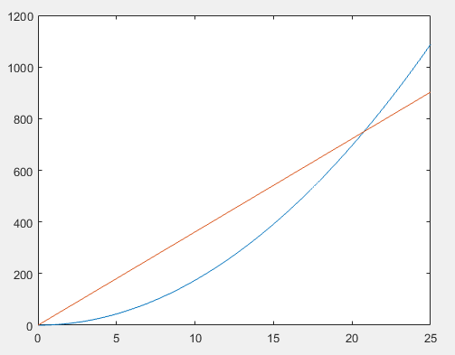
Solution HW2-3
x
(a)
,
xs(t) = Vo*t
xp(t) =
(b)
t

